Slide 1
High Cloud Airlines
Business & Data Analysis Project
Group:6
Geeta Dasari
Savita Shinde
Murade Nikita
Soumya T
Anurag Singh
Tanvi Pisat

Slide 2
Introduction

Slide 3
High Cloud Airlines offers airline companies valuable insights into Market Trends, Customer Behaviour and Operational Performance.
Project Purpose: Analyze operational & financial data, identify key performance trends, and propose data-driven strategies for growth and efficiency.
In this project, our aim is to analyze and present the top routes (from – to- city) based on the no. of flights, along with identifying the load factor occupied on weekends versus weekdays.
We have provided comprehensive information on airline based on country, state, city and for each route.

Slide 4
Data Sources and Tools used

Slide 5




Data Source: High Cloud Airlines Data
Tools Used :

Slide 6
Key Findings

Slide 7
Based on the available data, we have analysed, there are 209 airlines operating 111K flights through 1406 airports, connecting 1296 cities across 104 countries.
According to data, first we find Load factor. It is the percentage of seats filled with passengers on a flight. It’s calculated by dividing the number of transported passengers by the number of available seats.
It measures how efficiently an airline fills its available seating capacity. A higher load factor means better capacity utilization.
After calculating the load factor, we compute it on a yearly, quarterly, and monthly basis.

Slide 8
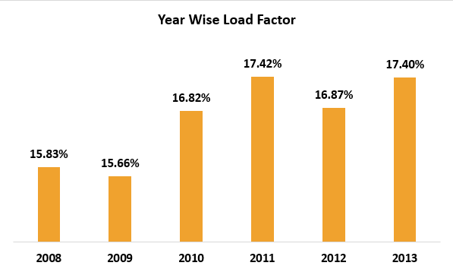
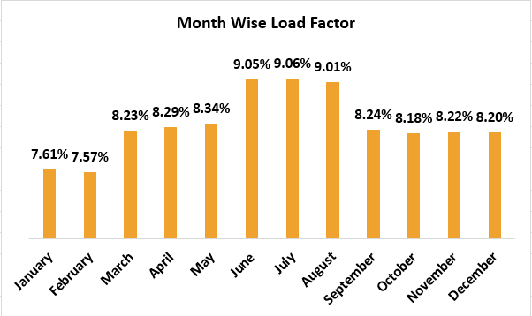
Among the airlines analyzed from 2008 to 2013, 2011 had the best load factor. The peak travel months were June, July, and August.

Slide 9
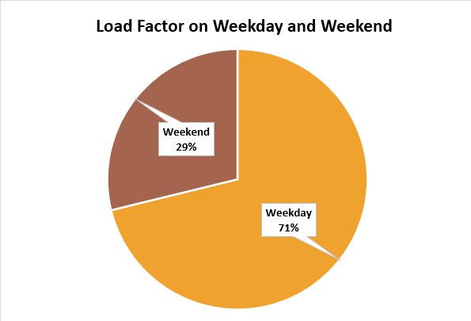
We observed that airline capacity is higher on weekdays than weekends, showing more passengers travel during weekdays.

Slide 10
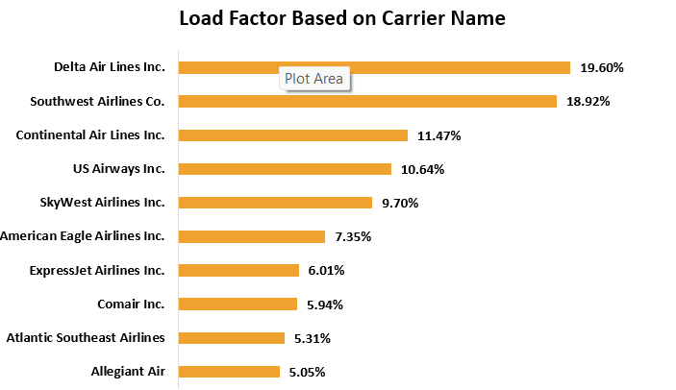
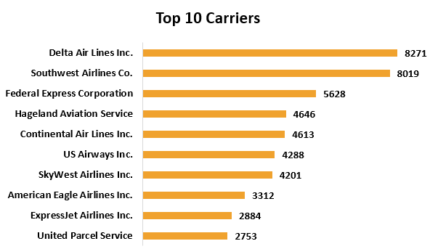
Among the airlines studied, Delta airlines ranks first in load factor, then Southwest airlines and Continental airlines.
Delta Air Lines and Southwest Airlines have the highest number of Transported Passengers, followed by Federal Ex. and other carriers.

Slide 11
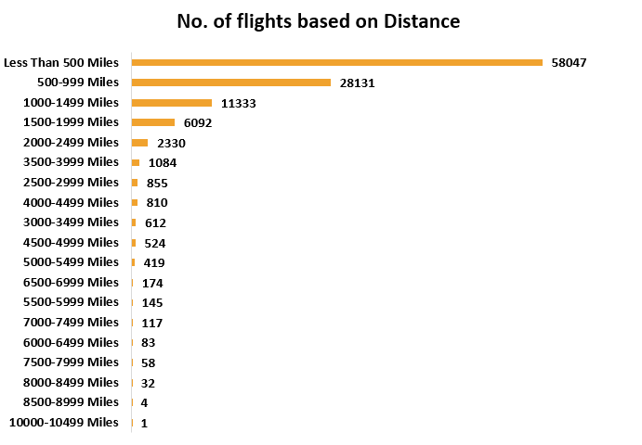
Most flights are under 500 miles, and the number of flights decreases as the distance increases. Very few flights cover long distances.

Slide 12
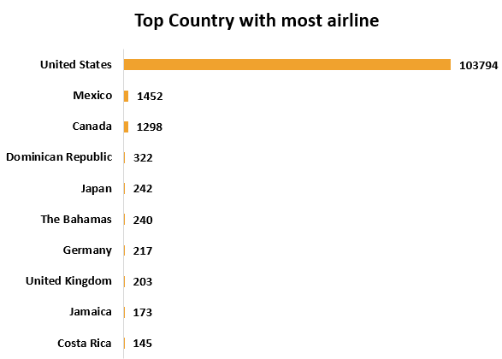
Top 3 Country with most Airlines:
The United States had the highest number of flights by a big margin. All other countries had much fewer flights.
United States — 103,794 flights
Mexico had 1,452 flights
Canada had 1,298 flights

Slide 13
Recommendation

Slide 14
The analysis shows that people prefer to travel on weekdays more than on weekends.
This gives airlines a good chance to add more flights in the USA, especially on busy routes where there are fewer other airlines. By offering more weekday flights in these areas, airlines can attract more passengers and increase their earnings.
Using data about when and where people like to travel, airlines can adjust their flight schedules to fill more seats, use their planes better, and make more profit.
Over time, this smart and careful planning can help airlines grow, stay competitive, and keep their customers happy.

Slide 15
Visualization

Slide 16

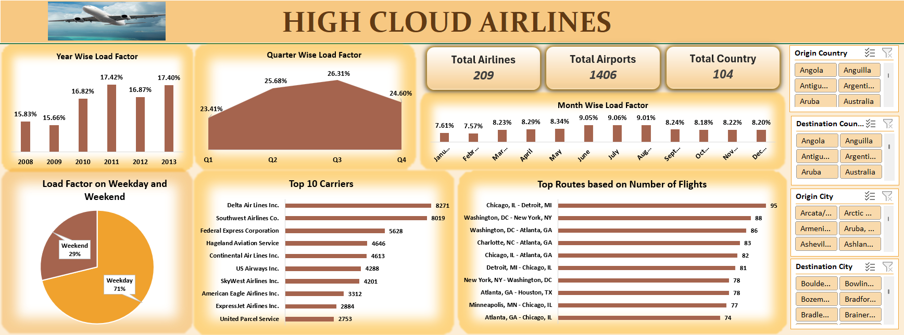
Dashboard in Excel

Slide 17
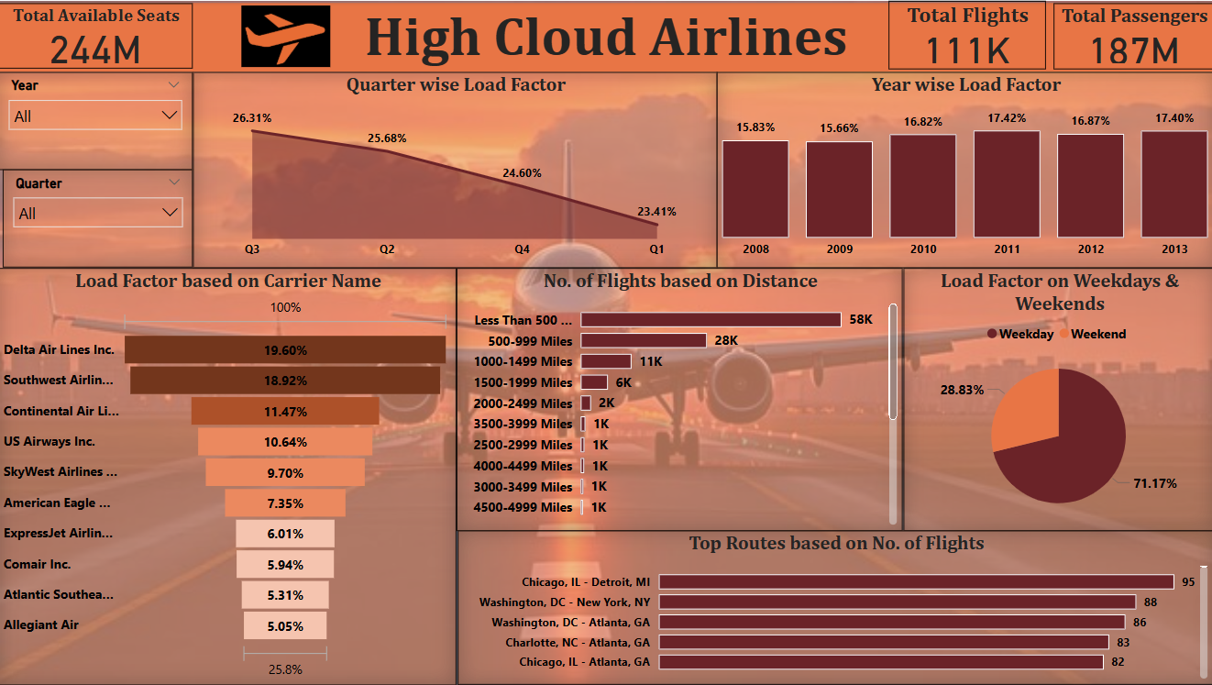
Dashboard in Power BI

Slide 18
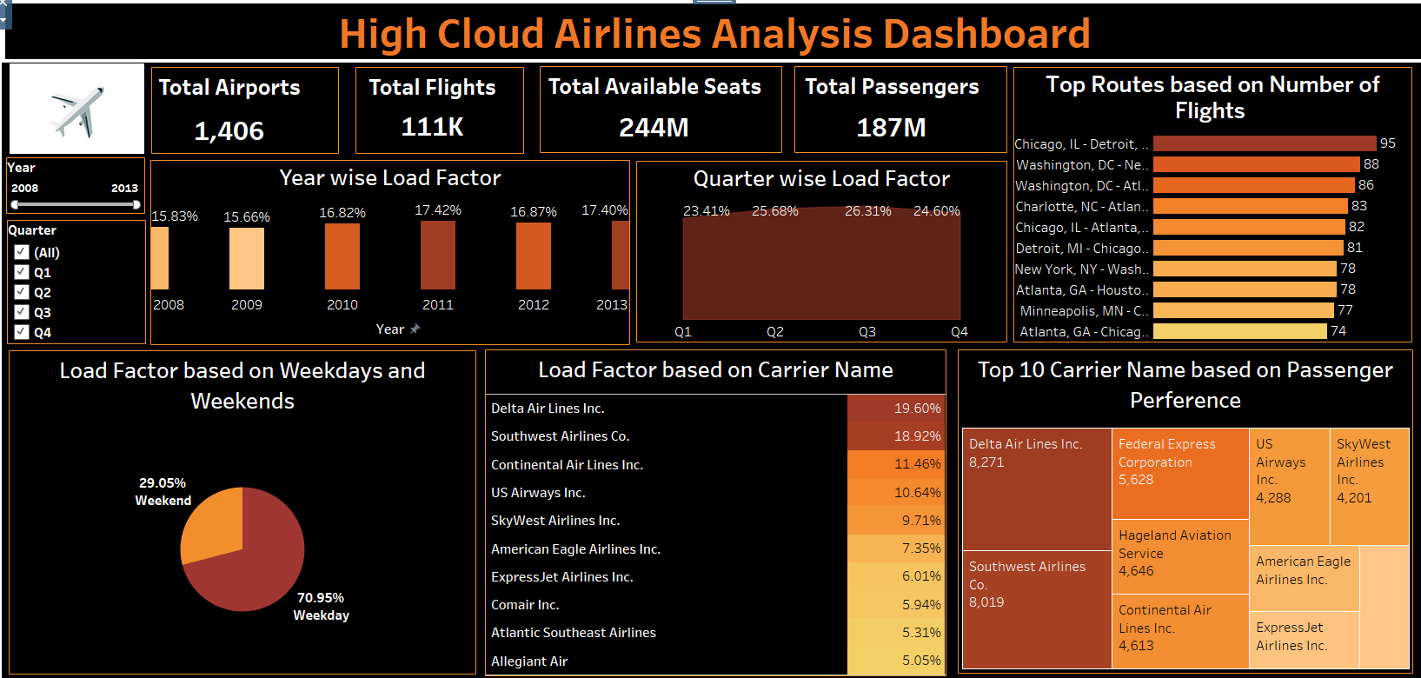
Dashboard in Tableau

Slide 19
Conclusion

Slide 20
The study of passenger travel habits and airline performance shows a good chance for airlines to improve their business.
By adjusting flight schedules to match when and where people like to travel, especially in busy areas, airlines can make more profit and grow their business.
Using data to guide these decisions will help airlines stay strong in a changing market and succeed over time.

Slide 21

Thank You

